Slide 1
Secure mobile banking in a consumer IT world
An innovative approach to identity and verification
Martin Gale, Industry Architect
Stephen Pipes, Information Security Specialist

Slide 2


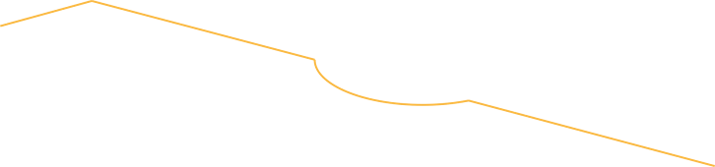
We have entered the age of the empowered customer
  Customers now have unlimited access to information and can instantly share it with the world
  Social networking and mobile commerce have dramatically changed the dynamic between buyer and seller.
  Customer expectations of service, price and delivery is soaring.
  This is changing
  the entire way financial products are delivered, sold and serviced by banks—and making relationships more complex
  than ever.
155 million
Number of tweets sent via Twitter each day and growing
90%
Percentage of bankers that believe that transforming from the status quo is critical to profitability
55%
Percentage of Gen Y over the general population that conduct mobile banking
Notes:
There is a new breed of customer, dictating a new set of terms in the dynamic between buyers and sellers. An empowered customer generating an explosion of mobile and social interaction. For example:
5B mobile phone connections globally
600M+ user of Facebook
45% of consumers ask friends for advise before purchasing
64% of consumers make a first purchase because of a digital experience
These customers are empowered by technology and transparency. They expect to engage with companies when and how they want, through physical, digital and mobile means. They want a consistent experience between all channels. They compare notes and instantly share. And they can champion a brand or sully a reputation with the click of a mouse.
Customer expectation is soaring –- at the same time that you are faced with increasing regulation that is raising your costs
++++++++++
Notes on “sparklers”
1.) From Tweeter
2.) The 90% sparkler comes from the recent IBM Institute for Business Value study, from complexity to client centricity, pg 3: http://public.dhe.ibm.com/common/ssi/ecm/en/gbe03395usen/GBE03395USEN.PDF
3.) The 55% of Gen Y over/ more usage than the general population that uses mobile is from a Javelin Strategy & Research study as reported on Finextra: http://www.finextra.com/news/fullstory.aspx?newsitemid=22403
Nearly a third of America's 'generation y' have used mobile banking over the last three months and many are prepared to switch providers to get it, according to Javelin Strategy & Research. When compared to the general populations use, Gen Y uses mobile about 55% more often than the general public. And, bankers should care because:
With Gen Y (12-32 year olds) set to earn more than any other generation within 10 years, banks need to tap technology to attract them, offering services such as mobile, personal finance management and person-to-person payments, says Javelin.
About 28% of Gen Y consumers have used mobile banking in the past 90 days, compared with 18% of all people. (From where the 55% number is derived) Not only do they use it, young people switch banks for it, use it frequently, and value it.
Javelin's research also shows that Gen Y consumers have a lower satisfaction rate than that of the general population, which produces a higher switching rate and increases customer retention costs.
These customers are empowered by technology and transparency. They expect to engage with companies when and how they want, through physical, digital and mobile means. They want a consistent experience between all channels. They compare notes and instantly share. And they can champion a brand or sully a reputation with the click of a mouse.

Slide 3



These disruptive forces ripple from the customer
Individuals
The connected customer
The networked workforce
The empowered citizen
"The under 30 segment of our population is very large. We just need to understand their attitudes and preferences better, as they start to seek financial services.”
Senior executive, National bank, Asia Pacific
Enterprises
Evolved business models
Optimized digital operations
Connected enterprise
“The new normal for banks is going to be a lot more client-centric, with less focus on proprietary activities.”
Senior Executive, Global Bank, United States
Industries
Value migration
Value chain redefinition
Fragmentation
“Disintermediation of clients by smaller niche players (such as mobile players) is cause for concern.“
Financial Markets CEO, Canada
Notes:
These disruptive forces are rippling from the customers through to enterprise and across entire industries.
Individuals
Its not just about the connected consumer driving the “consumerization” of business; it is also about how your employees engage.
The networked workforce engages in new ways to collaborate both inside and outside the enterprise
The empowered citizen is increasingly digitally engaged and networked
These changes impact customer expectations, and the way they will want to interact with your bank
Enterprises
Business models must evolve to monetize and capture value across channels, products, services, customers
Optimized digital operations transform how products and services are created, marketed, sold, delivered and serviced
Your corporate banking customers are asking you, their bank, to be more easy to do business with; for example, think of remote deposit capture and how it is changing lockbox operations. Digitization and connected enterprise changes organization and people
Industries
Value migration as value shifts along the value chain, often moving closer to the end customer
Value chain redefinition – The roles and relationships of industry players across the value chain are changing
Fragmentation and disintermediation as new industry entrants change the broader ecosystems, capturing significant value: for example, in the UK, Tesco, or in the US, Walmart
++++++++++
The first quote comes from the recent IBM Institute for Business Value study, from complexity to client centricity, pg 10: http://public.dhe.ibm.com/common/ssi/ecm/en/gbe03395usen/GBE03395USEN.PDF
The second quote is by Elyse Weiner, managing director, global head, liquidity and investment, Global Transaction Services, Citi, as quoted at SIBOS 2010. http://www.swift.com/sibos2010/home_page/publications/sibos_issues/wednesday.pdf#page=7
The 3rd quote is original from the horizontal deck

Slide 4
Banks need to address these disruptive forces while rebuilding customer trust
  In this new era, banks need to:
Realize that Fragmentation and disintermediation are forcing you to change the way you engage with customers
Recognize and embrace social media as ”web 2.0 is a game changer “
Understand and anticipate customer behavior and needs based on customer insights across all channels
Optimize customer interactions across banking business processes
Rethink how they source information and financial products
Market and sell the right product and service at the right price, time and place
Service customers flawlessly, predict and drive customer loyalty
Notes:
Banks need to addtess these disruptive forces while rebuilding customer trust
In this new era Banks need to:
Realize that Fragmentation and disintermediation are forcing you to change; for example, Tesco in the UK, or Walmart in the US. And, for example, 10 years ago, who heard of Pay Pal, they were just some silly little service that EBAY thought up to help their customers buy goods on EBAY. It was thought to amount to much, but Pay Pal is old news now. What about Square or Facebook money—not a worry? Now, you can manage your Starbucks card on Facebook and send gifts and get reviews. But, what about a few years from now, when I can buy my Starbucks coffee with my Facebook credits by downloading and transferring Facebook money for Starbuck’s money, while online with my mobile phone? Or, a few more years, when Starbucks goes to get beans from Vendor A in COUNTRY B with the same with its Facebook money / credits, replenishing its inventory without cash or banks?
10 years ago this would have been a far fetched fantasy, but today, it isn’t out of the realm of possibility.
Recognize and embrace social media as ”web 2.0 is a game changer “ A Major US Bank, just announced its new presence in Manhattan by doing a “flash mobbing” and posting it on You Tube, and even getting coverage globally: (http://thefinanser.co.uk/fsclub/2011/04/flashmobbing-in-the-usa.html)
Understand and anticipate customer behavior by listening to their customers and turning insight into action. Its not just about predicting, or re-acting, but instead, anticipating behavior, needs, wants, and therefore buying patterns, and therefore…
Deliver to customer demand and orchestrate the buying and servicing of products seamlessly, even if it means that you source the product/service from a partner, white-label it and sell it
Market, sell and fulfill the right product and service, at the right price, right time and place, across multiple channels of the bank
Service their customers flawlessly and learn from their behavior to predict and take action to ensure retention and drive loyalty

Slide 5



Three imperatives for Smarter Banking
Reinvent the business model
Drive a simplified and streamlined agile enterprise that balances growth, efficiency and business resiliency
Focus on
the customer
Optimize data and leverage analytics
to make informed decisions, deliver client-centricity and drive profitable growth
Integrate risk management
Achieve compliance objectives while mitigating operational risk, fighting crime and optimizing financial returns
Notes:
When we consider the external forces driving bankers to change, and the “smarter actions” they can take, we tend to think in terms of three imperatives:
Customer-centric experience – enabling customers to shop however, whenever and wherever they want
Flexible and cost-effective operations – updating systems to better handle today’s complex demands,
And, integrated risk management, not only to achieve compliance with mandates and to fight fraud and crime, but also other operational risk areas, such as protecting customer data and privacy, which if the new legislation that Senators Kerry and McCain are proposing will be come even more critical, as the law will be about tracking customer information, and the sharing and storage of that information.

Slide 6

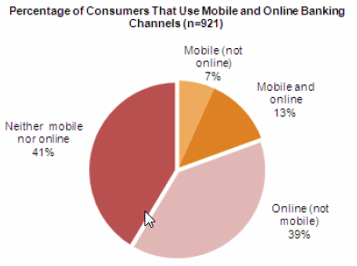
Mobility is here and making a difference for banking
  8x
Mobile banking will fundamentally change retail banking
Bankers say mobile devices will transform retail banking but aren’t investing enough to exploit the opportunities
Since 2008 adoption of mobile banking has nearly doubled
Source: EFMA and McKinsey & Co. The current state and future of mobile banking in Europe, Aug 2011
2011
The year mobile platforms surpassed traditional platforms IDC …Which happened 4 years earlier than predicted in 2009
2 Billion
eBay expectation to be transacted via mobile — up from $400 million in 2009. Forrester
20% of consumers are mobile banking users
Source: Aite Group, The Impact of Mobile Banking: A Case for Mobile Marketing, April 2011
Notes:
Notes:
Banks that have mobile
Alerting
Faster growth in Canadian market
20% usage increase month over month
Mobile offers a different value:
Context Awareness: Mobile is able to deliver targeted functionality that considers the user’s context (location, time, presence, capabilities and social context).
Push Notifications: Web interactions are always initiated by the user; mobile offers the ability for enterprises to pro-actively initiate conversations with end-users as soon as relevant events take place.
Immediacy: An always-connected communications tool, mobile with a unique platform for information immediately.

Slide 7
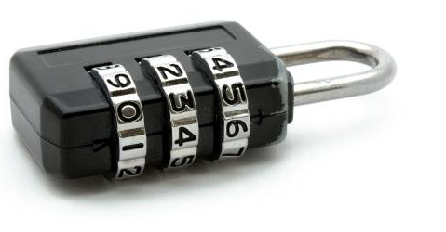
The challenge of security
Demand for mobile banking introduces competing pressures for the organisation seeking to innovate yet remain secure.
Trust in new technology
User experience
Marketplace competition
Consumers and banks need to be comfortable with the risk profile of mobile devices.
Consumer IT has created a high end user expectation of the digital experience.
Many more organisations now accessible and vying for consumer attention.

Slide 8
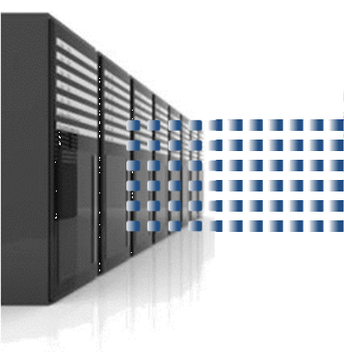
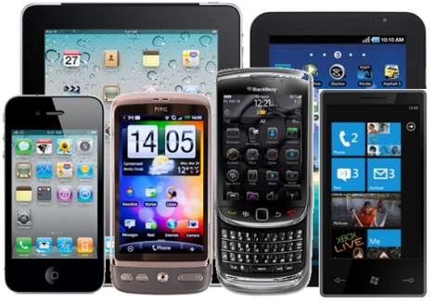
The problem of “friction” in mobile security
Traditional techniques such as PIN numbers are proven and accepted means of authentication, yet are highly disruptive the consumer experience.
Significant competitive advantage can be gained by the organisation offering a superior experience without compromising security.
Notes:
Let’s consider the technical challenges of authentication. Our principle concern is with the usability of passwords and PINs. Whilst PINs are commonly used for mobile authentication, they depend on the user’s ability to recall the required information when prompted. The prompting in itself is disruptive to the user experience but worse still, PIN’s (and particularly passwords) can be difficult to recall. This is due to their inherent variability. We are probably all familiar with the need to use passwords that are hard to remember – this simply translates into confused and impatient users. If those users are your customers, then the business suffers.
So, we would like to find secure alternatives to the problem of “friction” caused by PIN- and password-based authentication and in doing so develop a competitive business advantage.

Slide 9
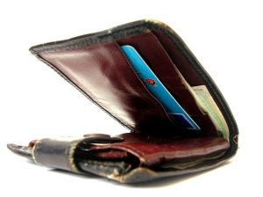
A client scenario – a major credit card
A key business imperative for the organisation is to improve customer experience through exploitation of digital consumer channels.
A mobile app has been introduced to extend their reach to consumers using smartphones and tablets.
A six digit passcode is provided to verify identity – if forgotten, the app must be reinstalled.
Both the passcode and recovery process impact consumer ease of use, and adoption of the mobile channel.
Question
How can they provide a secure yet “low friction” solution for their customers?
Notes:
As part of an IBM initiative called Extreme Blue, we have been engaging with a major credit card company in the UK. This company is keen to enhance their customer experience through effective exploitation of consumer channels.
The company provides their customers with a mobile app for performing certain read-only operations, such as a balance check. To log in to the mobile app, mobile users must recall a six digit PIN. If the mobile user cannot remember their PIN, then the app must be reinstalled on their device – clearly a major inconvenience to the mobile user and to the business.
The company emphasised that they must manage user support costs without pushing the problem to another part of the business. Our challenge was to develop a solution that lowers the friction caused by traditional authentication whilst retaining the security required by the business.

Slide 10

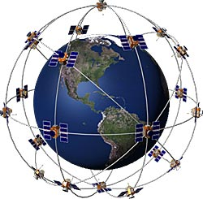
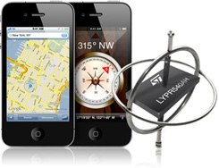
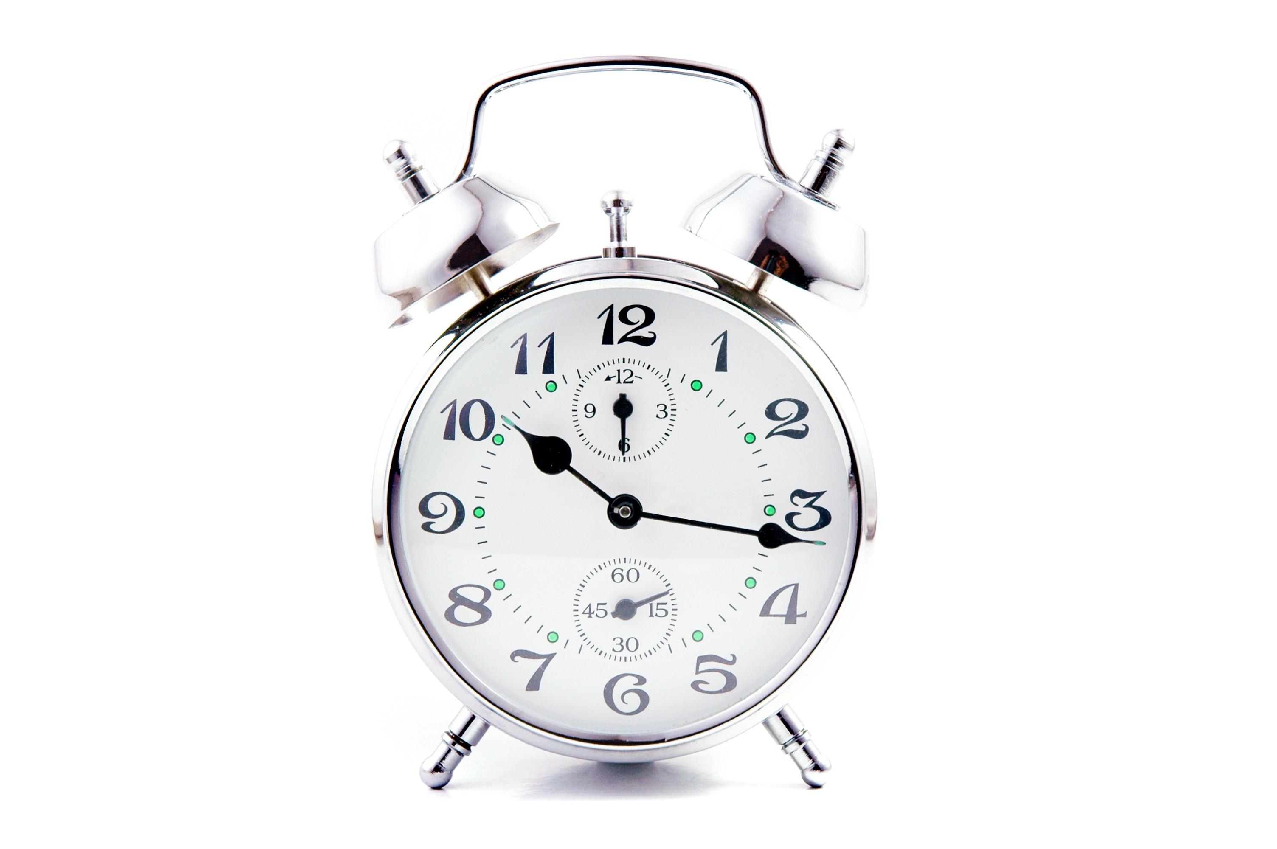
Introducing a smarter approach to mobile authentication
By gathering data from an array of different sources, a trust level can be established that the current user is who they are supposed to be.
Home router.
Laying flat.
At home.
e.g. the device is in the user’s home at a time when they are typically in.
In the evening.
Notes:
The solution that we developed demonstrates an innovate approach to mobile authentication. The solution is based on a layered approach to authenticating the mobile user. Rather than relying on the user’s ability to recall a PIN, this solution gathers information about the user from a variety of sources. This information is used to build a context which represents the user – for example, the user’s current location, the time of day and their wireless network identity may all be useful sources of contextual information. Analysis of this context (in real-time) produces a “trust” metric, which represents the confidence the business has in the identity of the user (in other words the level of confidence that the user is who they claim to be).
Imagine a scenario in which you, as the mobile user, simply want to check your balance. You’re at home, in the evening, connected to your home wireless network – a fairly low-risk scenario. Wouldn’t it be convenient if all you had to do was open the app and it would authenticate your “context” without prompting? Of course, in other scenarios, you might expect the system to interrogate the user in more detail before giving access to the account details. We describe several scenarios later that demonstrates the flexibility of this solution.

Slide 11
Mapping trust levels to tiered authentication requirements
Establishing a variable level of trust enables the organisation to specify a sliding scale of friction required to authenticate depending on the task.
Low trust
Medium trust
High trust
Strict authentication required for all tasks – lowest trust, highest friction.
Some tasks possible without authentication – high friction only for high risk.
Tasks possible without additional authentication – low friction even for some high risk.
The organisation tailors an authentication policy that seeks to minimise the degree of end user friction wherever possible – giving the best possible user experience.
Notes:
With our solution, the business retains complete control of risk. The business defines a risk profile which consists of several levels of trust, with each level dictating authentication requirements. This way, the business can balance the usability and security in a flexible, real-time way that takes advantage of the capabilities of modern mobile phones and tablets.
For instance, a risk profile may define three levels of trust. These are:
-- low, which relates to scenarios that require enforcement of strict authentication policy for all user tasks. This may result in the highest degree of friction;
-- medium, which relates to scenarios whereby some tasks are permissible even with lower friction methods of authentication;
-- low, in which most tasks are permissable with the lowest friction possible (which may remove the need to prompt the user altogether).
We believe that getting the balance right between usability and security is key to delivering the best possible user experience.

Slide 12

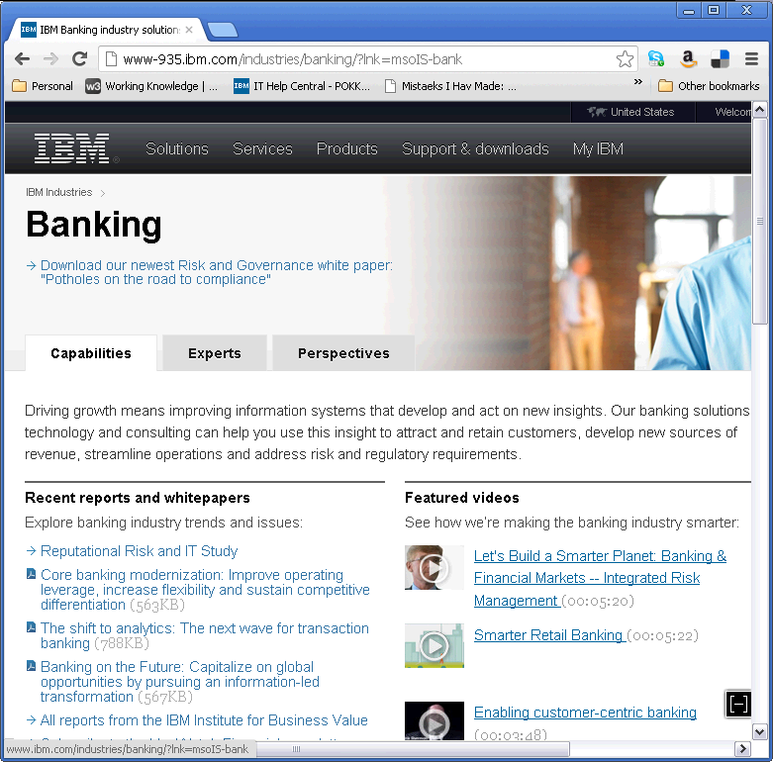

A solution to match the level of trust required to the trust level generated
User request
User preferences
Mobile Enterprise Application Platform
Customer preferences application
Analytics engine
Tailored authentication levels
Predictive models
User’s specific policy
Tailored Policy Store
Enterprise Integration
Required authentication
Authenticated request
Rich data store
“Background” data
Tiered authentication levels
Data ingestion
Issuer policy definition application
Issuer Core Processing Platform
External feeds
Notes:
This is a view of the solution that we are currently trialling. On the left is the mobile user channel:
-- the user’s device which is used to collect all information for authentication – this may be data collected in the background, such as location, movement, ambient sounds etc, and data collected through prompting the user;
-- and the mobile channel integration with the business’ core processing platform.
A central feature is the analytics capability, which combines predictive model analysis with rich contextual data to provide the flexible, risk-orientated authentication functionality.
On the right is the policy engine which dictates security criteria and allows both the user and business to tailor the user experience. The business defines a risk profile which is linked to trust levels, as described. The mobile user tailors these trust levels by selecting preferred authentication methods (from the list offered by the business).

Slide 13
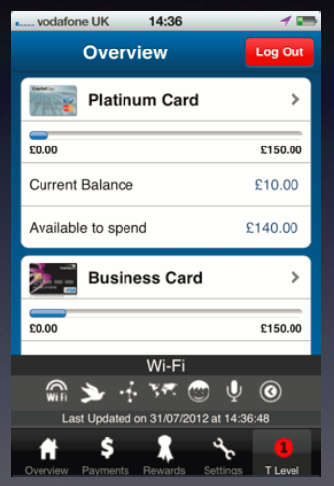
The Extreme Blue Solution
The Extreme Blue team have developed a solution which uses a tiered and tailor-able authentication model to reduce and in many cases remove the friction for the customer
In many customer scenarios the background data trust level will be sufficient to enable authentication with no active customer input – removing the friction and greatly improving customer experience
Notes:
On to the implementation. The screenshot shows the account summary page of the mobile app. First of all, the top-half of the screen shows the current app, without modification. The user has logged in and we can see which data sources and authentication methods were used during authentication – these are indicated on the lower part of the screen. Each authentication method has an associated icon; Wifi represents the wireless network id, the bird icon represents the Twitter service, the world is GPS, the microphone is ambient noise and so on. Also indicated on the bottom right-hand corner is the current trust metric. Remember how the risk profile (defined by the business) dictates how much confidence they place in an authentication? In this screenshot, the trust metric indicates a low confidence: we would expect the business to allow the user to perform only low-risk tasks.
One point to note is that the mobile user had not been prompted during authentication. This is confirmed by the authentication methods on display – they all “background” data sources and require no user intervention. This brings us back to the “at home” scenario previously described. You’re at home, you want to check your balance and you want the experience to be slick and easy. We envision other scenarios that meet this “low risk” criteria; this solution will help remove friction and greatly improve the customer experience.

Slide 14
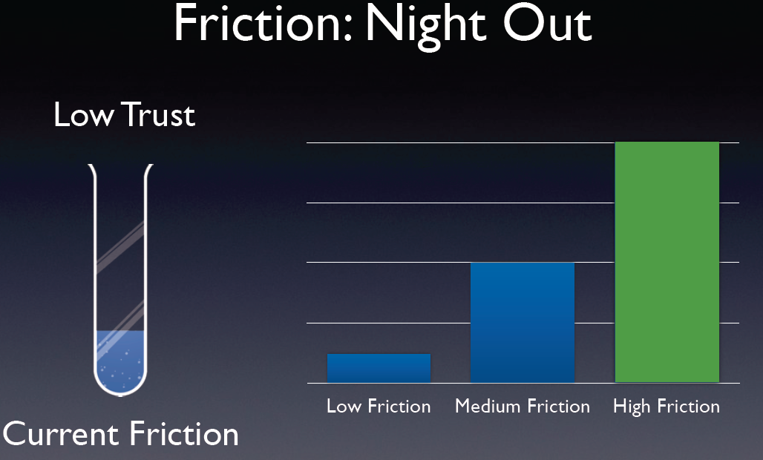
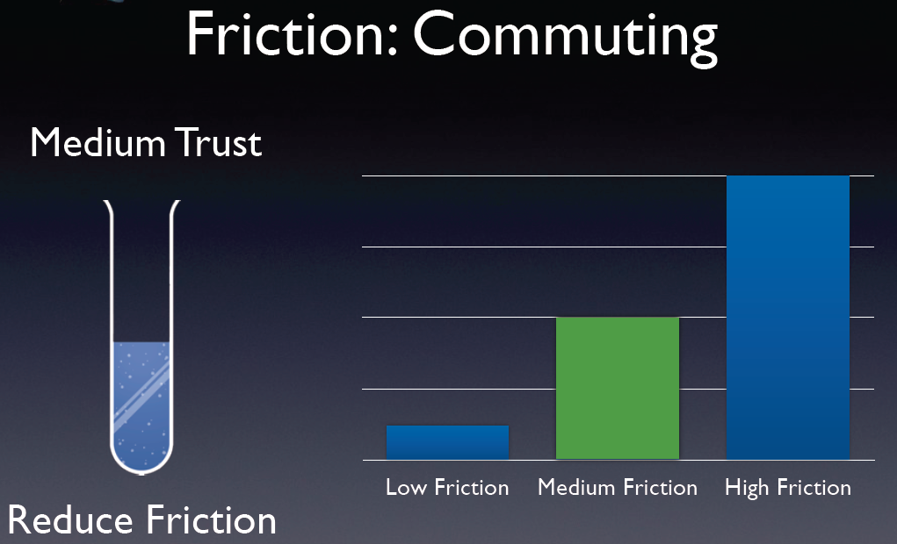
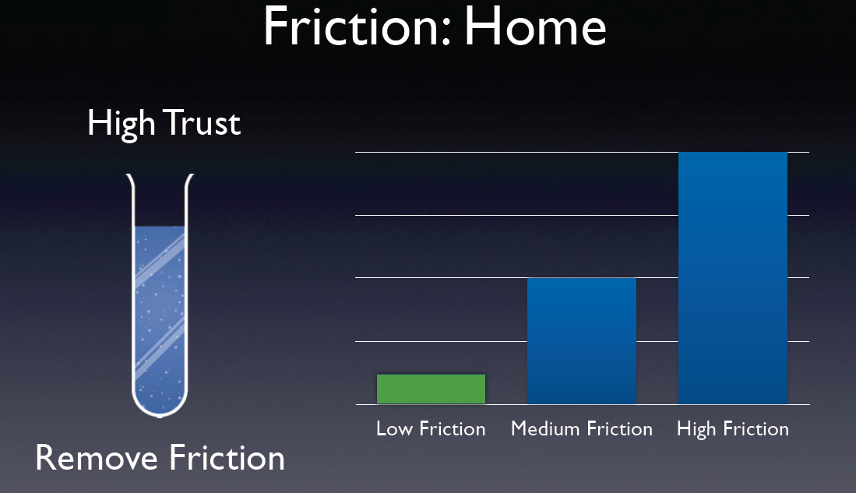
Example Scenarios
 | Example Customer Scenario | Lower Risk Transactions – e.g. Open App Home Page, Review Balance, Read Previous Transactions | Higher Risk Transactions – e.g. Transfers and Payments
Low Trust | “Night Out” City centre location, late at night, loud background noise | e.g. Photopass (Some Friction) | e.g. PIN (High Friction)
Medium Trust | “Commuting” Normal commute journey, early evening, no sudden movements | Background Data (No Friction) | e.g. Gesture Recognition (Some Friction)
High Trust | “At Home” Home location, daytime or early evening, low level of background noise | Background Data (No Friction) | Background Data (No Friction)
Notes:
We have defined three scenarios that demonstrate the flexibility of this solution. Each customer scenario is treated differently by the risk profile defined by the business. The first scenario involves a mobile user, on a night out, logging into their account from a city centre location, late at night. This scenario is deemed high risk and is represented with a low trust metric.
The second scenario involves a mobile user on their regular commute home.
The third scenario involves a mobile user at home in the evening.

Slide 15
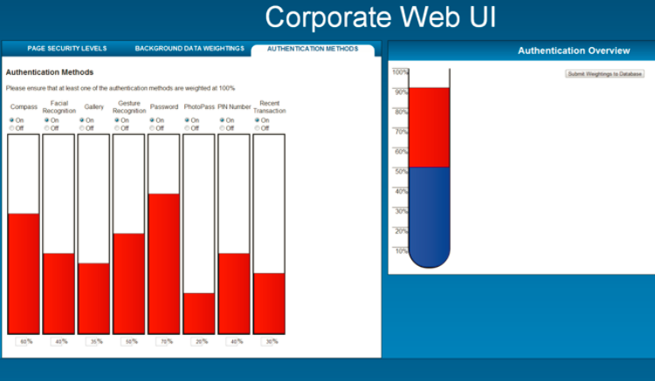
Additional Features and Benefits
The app includes an intuitive trust rating and dashboard for the customer - enabling the customer to see why and how they are trusted by the enterprise - in doing so increasing their own trust in the mobile app and the enterprise - increasing likely uptake and usage of the digital channel
The customer can determine which background data is used – giving them control over how they are trusted
The solution enables the enterprise to dynamically change levels of trust and authentication methods used without changes to the mobile app - enabling new threats to be quickly addressed
Notes:
Additional features of our solution includes a “corporate dashboard” which enables the business to align risk profiles with authentication methods. The solution supports fine-grained access control, down to the granularity of an individual page in the app.
The solution also provides a “customer dashboard”, not shown here, in which the mobile user can select their preference of authentication method. This dashboard does not allow the user to modify the risk profiles assigned by the business but simply provides a degree of flexibility towards improving the overall customer experience.

Slide 16
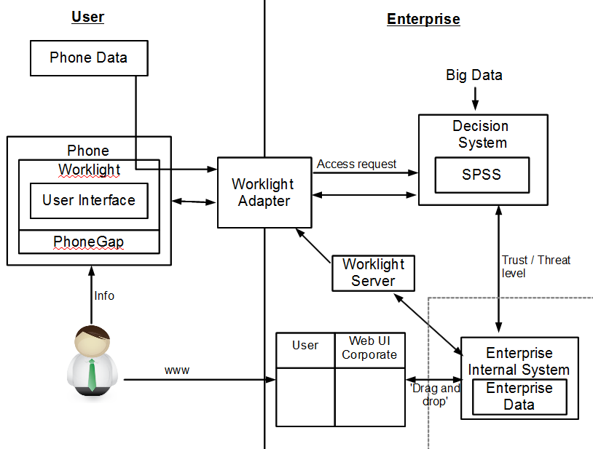
High Level Component Architecture
Notes:
Finally, this is the high-level component architecture of the solution. Note that IBM Worklight takes centre stage – we use Worklight’s mobile capabilities in the current PoT. There is scope, however, to consider alternative mobile platforms and messaging infrastructures.

